Slide 1

processing a Transcription-analysis with R
Author: Claudia van der Zijden and Tiara Verweij

Slide 2


abstract
As the world becomes increasingly digital, more and more biomedical engineers are lagging behind in the use of data analysis programmes. now that research can take place on an increasingly larger scale, there is a high demand for easy-to-use functions within R that biomedical engineers without programming skills can use. this project is about the data processing of a transcription analysis of Covid. with the ultimate goal that our script can be used for any transcription analysis.
Our main research question:
Can we make a function that can import data from a transcription analysis and process the data to a quantification file?

Slide 3
Background information
the data that can be used for our product are transcription analyses. the data processing of a transcription analysis follows the following workflow: Results Dataset (fastq) -> Salmon (or other quantification programme) -> Tximport/tximeta -> Summarised experiment or count matrix - > Shiny App. Tximport/tximeta is for importing salmon’s transcript-level quantifications and aggregate them to the gene level for gene-level differential expression analysis
Salmon: Transcript quantification from RNA-seq data
Salmon is used to quantify the abundance of rna transcripts using RNA-seq data. After the salmon commands finish running, you should have a directory named quants, which will have a sub-directory for each sample. These sub-directories contain the quantification results of salmon, as well as a lot of other information salmon records about the sample and the run.

Slide 4
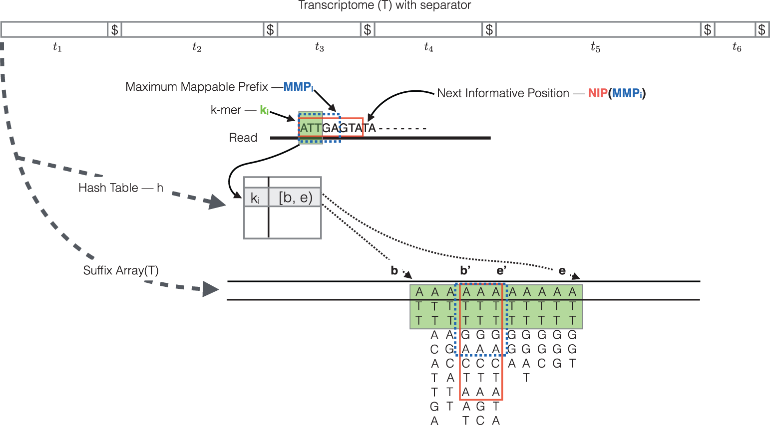
More about Salmon
What is salmon and how does it work?
Indexing
Quasi mapping and abundance estimation
RapMap: a rapid, sensitive and accurate tool for mapping RNA-seq reads to transcriptomes. A. Srivastava, H. Sarkar, N. Gupta, R. Patro. Bioinformatics (2016) 32 (12): i192-i200.

Slide 5
Our product
https://github.com/ProjecticumDataScience/Project-3-lectoraat

Slide 6
for the next researchers
Using Tximport/tximeta
Deseq2
Shiny App

